Slide 1
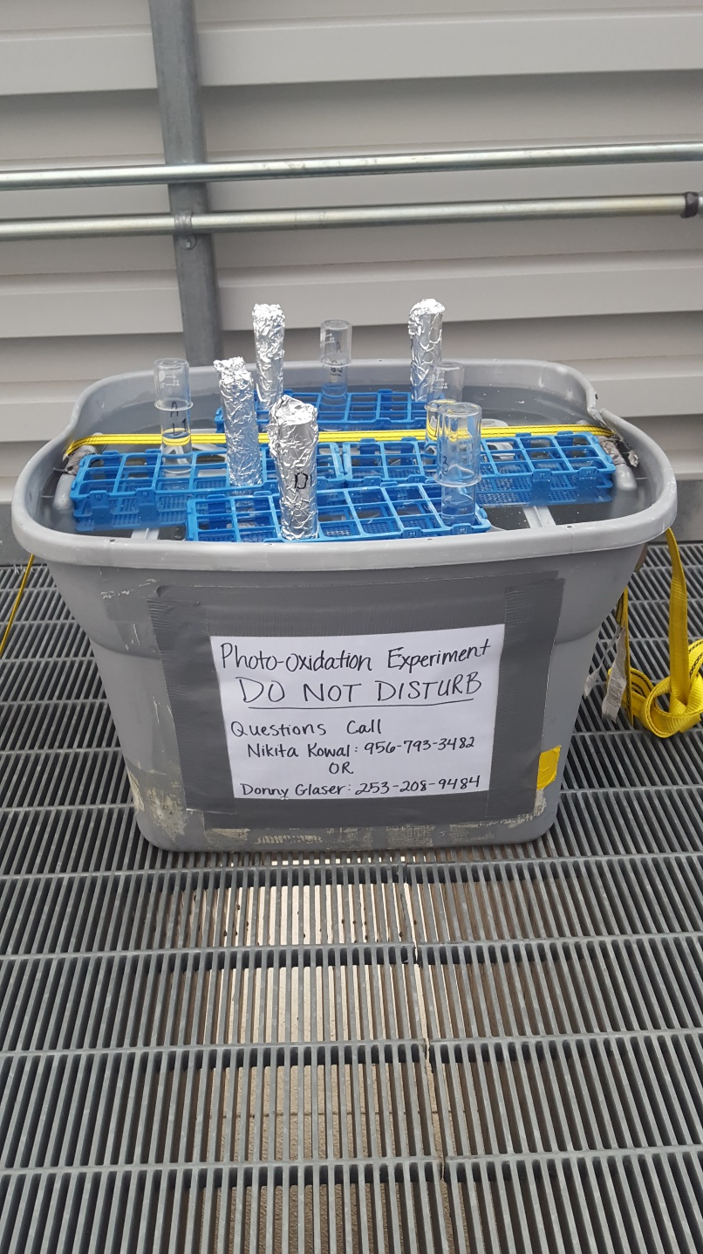
Photo-oxidation effects on Tempe Town Lake
Nikita Kowal
Mentor: Dr. Hilairy Hartnett
ASU/NASA Space Grant Program

Slide 2


Overview
Project Description
  Background
  Research Question
Procedure
Results
  Fluorescence Indices
  PARAFAC Modeling
Conclusion
Acknowledgements
Notes:
What does photo-oxidation mean?
plastic chairs
Picture of plastic lawn chair AND lake

Slide 3
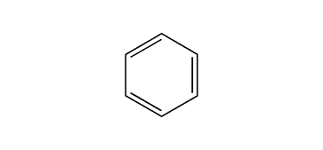
Background
  Lawn chair vs. lake
  Photo-oxidation is the degradation of organic carbon
  UV Light interacts with conjugated double bonds
Research Question
How does photo-oxidation affect organic carbon in Tempe Town lake?
Notes:
Title background.
Hidden Research Question, then pop up (animation)
Key concepts:
water quality and relationships to organic carbon
light breaks down organic matter in lake same as lawn chair
the degradation of organic carbon by light.
uv light interacts with conjugated double bonds

Slide 4
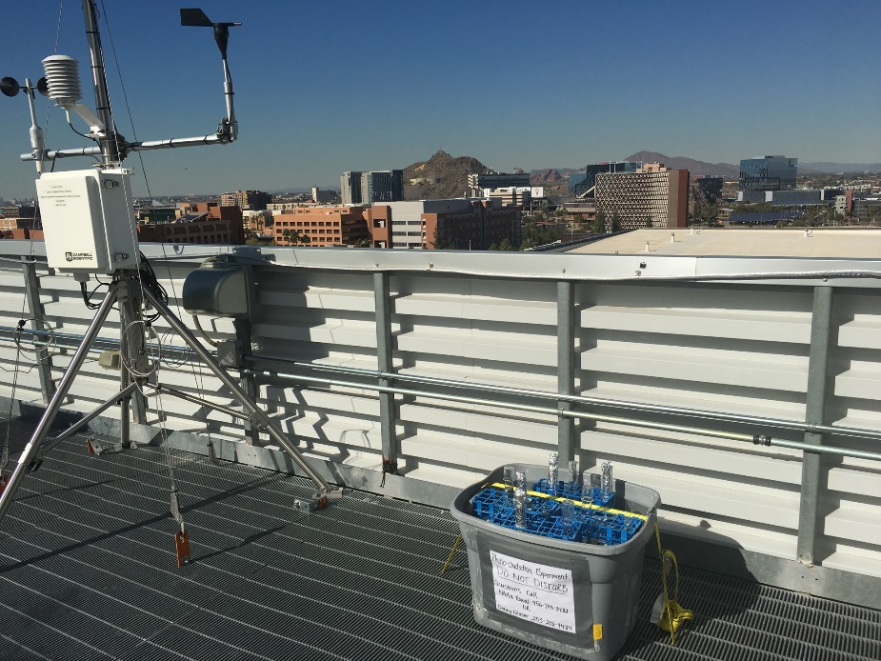
Procedure
Sampling:
  Tempe Town Lake
  3 L of Lake Water/1 L Field Blank
Lab:
  Autoclave all samples to sterilize biology
  Fluorescence Spectrometer (Initial and Final)
Rooftop Experiment:
  3 Light/3 Dark
  Quartz tubes
  Double-Wrapped in foil
  7 Day time period
Notes:
Sterilize the biology
Use quartz tubes
NEW SLIDE:
Explain fluorescence
Picture of fluorometer, and
corrected eem pictures (1 intial, final dark, final light)
uses UV wavelength range to test

Slide 5
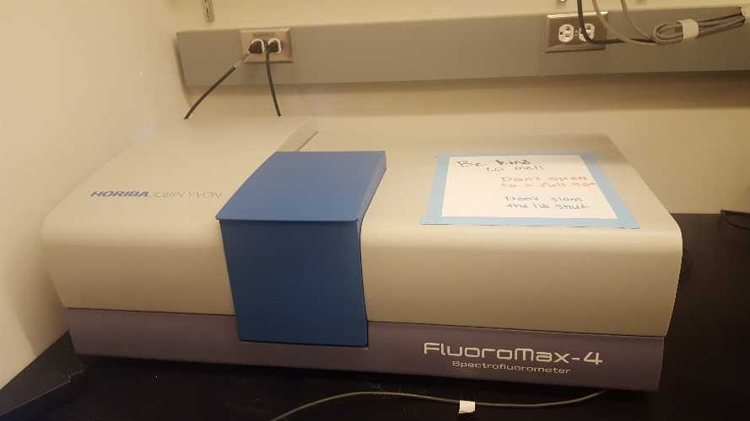
Fluorescence Spectroscopy
Initial
Dark
Light
Notes:
uses UV wavelength range to test

Slide 6
Results: Fluorescence Indices Change in Light-Exposed Samples
Notes:
Total Fluorescence
Fluorescence Index: Microbial or Terrestrial
Humification Index: Longer wavelengths
Freshness Index: Ratio of b and a. alpha is more decomposed (lower the value, higher the alpha)
Fluorescence Indices change in light-exposed sampes (TITLE)
Humification – aromatic
Freshness – degraded
Fluorescence index – loss of aromatic stuff
TAKE out decimal points in y-axis.
Put in 1st bar chart first, then animate the next ones.
Make light bar the lighter color.

Slide 7
Results: PARAFAC Modeling
Cory and McKnight 2005
Notes:
Make just light and initial.
Model based on a lot of samples
Group by categories of mol
ecules

Slide 8
Results: Change in Light Samples from Initial Samples
Notes:
Take dark ones out
Different molecules show different decreases.

Slide 9
Conclusion
Light samples show change, dark do not.
Therefore, photo-oxidation alters the amount and composition of fluorescent matter.
Future Directions…
How do bacteria alter organic matter?
Test other urban lakes and reservoirs.
Application – planning/design of new urban lakes.
Notes:
Light samples show change and dark do not
photo-ox alters amount and composition of fluorescent matter
Future directions
how do bacteria alter organic matter
other lakes

Slide 10



Acknowledgements
Special Thank You to:
Dr. Hilairy Hartnett
Donald Glaser
Joshua Nye
CaNDy Lab
Notes:
References?

